Slide 1

Memory
Chris Piech
CS106A, Stanford University

Slide 2


Learning Goals
Be able to trace memory for objects
Be able to trace memory with instance variables

Slide 3
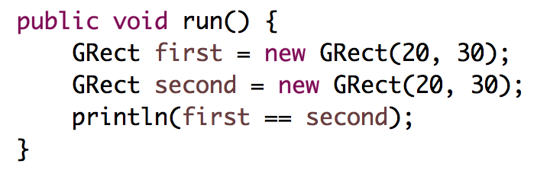
Who thinks this prints true?

Slide 4
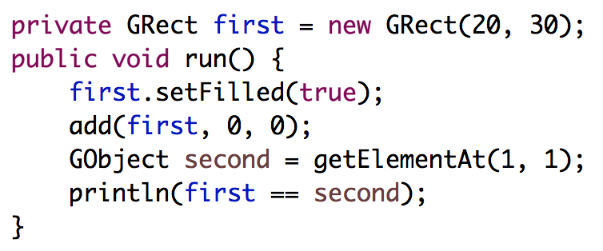
Who thinks this prints true?

Slide 5
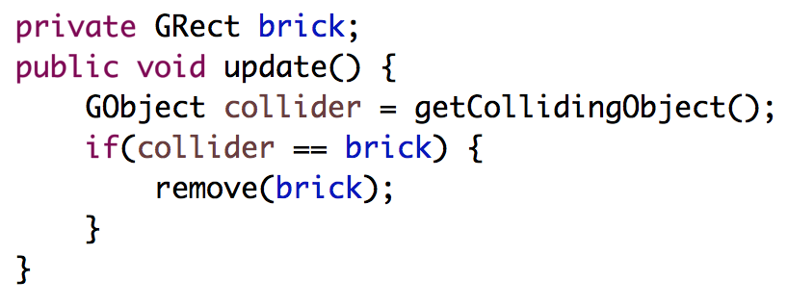
Deep Understanding is Key

Slide 6
[suspense]

Slide 7



Today’s Route
You are here
Friday
Instance
Variables
Canvas
The Heap
Core model
The River of Memories

Slide 8
Core memory model

Slide 9
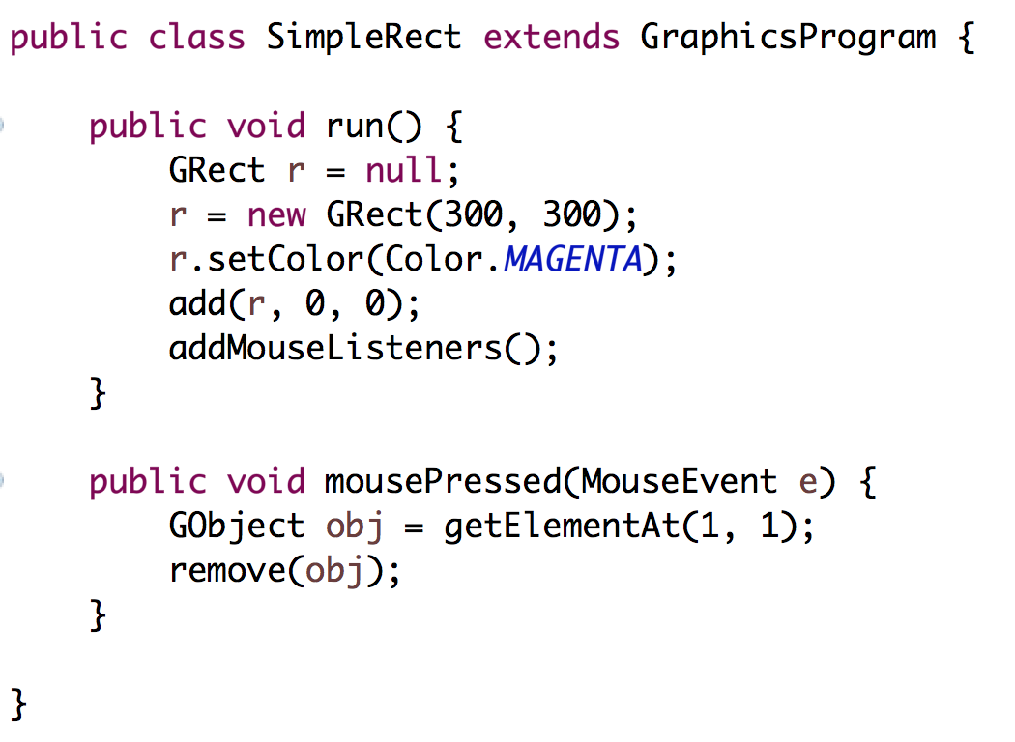
Stack Diagrams
public void run() {
println(toInches(5));
}
private int toInches(int feet){
int result = feet * 12;
return result;
}

Slide 10
Stack Diagrams
public void run() {
println(toInches(5));
}
private int toInches(int feet){
int result = feet * 12;
return result;
}
run

Slide 11
Stack Diagrams
public void run() {
println(toInches(5));
}
private int toInches(int feet){
int result = feet * 12;
return result;
}
run

Slide 12
Stack Diagrams
public void run() {
println(toInches(5));
}
private int toInches(int feet){
int result = feet * 12;
return result;
}
f
run
toInches
feet
5
result

Slide 13
Stack Diagrams
public void run() {
println(toInches(5));
}
private int toInches(int feet){
int result = feet * 12;
return result;
}
f
run
toInches
feet
5
result
60

Slide 14
Stack Diagrams
public void run() {
println(toInches(5));
}
private int toInches(int feet){
int result = feet * 12;
return result;
}
f
run
toInches
feet
5
stack
result
60

Slide 15
Stack Diagrams
public void run() {
println(toInches(5));
}
private int toInches(int feet){
int result = feet * 12;
return result;
}
f
run
60

Slide 16
Aside: Actual Memory

Slide 17
What is a bucket
feet
5

Slide 18
What is a bucket
feet
1011100111100011
0011010110010100
* Each bucket or “word” holds 64 bits

Slide 19
What does memory look like?
public void run() {
println(toInches(5));
}
private int toInches(int feet){
int result = feet * 12;
return result;
}

Slide 20
Stack Diagrams
run
toInches
inches
5
result
60

Slide 21
Actual Memory
run overhead
0011010011010001
1010110011010111
1111100000111100
0000111100001111
toInches overhead
feet
1011100111100011
0011010110010100
result
0101101110111101
1111011111101111
?
?

Slide 22
#0: don’t think on the binary level (yet)

Slide 23
Primitives vs Classes
Primitive Variable Types
Class Variable Types
int
double
char
boolean
GRect
GOval
Gline
Color
Class variables (aka objects)
Have upper camel case types
You can call methods on them
Are constructed using new
Are stored in a special way

Slide 24
Objects
GRect myRect = new GRect(20, 20);
Object

Slide 25
The Heap

Slide 26
public void run() {
GRect r = null;
}
stack

Slide 27
public void run() {
GRect r = null;
}
stack
run
r
null

Slide 28
Wahoo!

Slide 29
public void run() {
GRect r = new GRect(50, 50);
}
stack
heap
run
r

Slide 30
public void run() {
GRect r = new GRect(50, 50);
}
stack
heap
run
18
r

Slide 31
public void run() {
GRect r = new GRect(50, 50);
}
stack
heap
run
18
r
18

Slide 32
public void run() {
GRect r = new GRect(50, 50);
}
stack
heap
run
memory.com/18
r
memory.com/18

Slide 33
public void run() {
GRect r = new GRect(50, 50);
}
stack
heap
run
r

Slide 34
public void run() {
GRect r = new GRect(50, 50);
r.setColor(Color.BLUE);
r.setFilled(true);
}
stack
heap
run
r

Slide 35
public void run() {
GRect r = new GRect(50, 50);
r.setColor(Color.BLUE);
r.setFilled(true);
}
stack
heap
run
r

Slide 36
public void run() {
GRect r = new GRect(50, 50);
r.setColor(Color.BLUE);
r.setFilled(true);
}
stack
heap
run
r

Slide 37
What does an object store?

Slide 38
An object stores a memory address!

Slide 39
#1: new allocates memory on the heap

Slide 40
#2: object variables live on the stack and store heap addresses

Slide 41
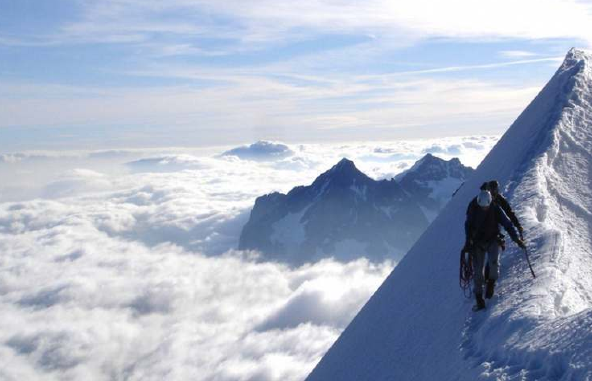
public void run() {
GImage img = new GImage(”mountain.jpg”);
add(img, 0, 0);
}
stack
heap
run
img

Slide 42
#3: GImages look impressive but don’t take much extra work

Slide 43
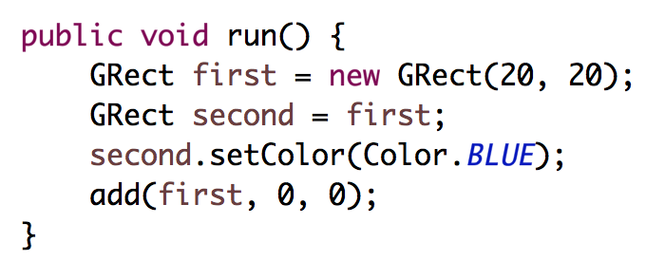
stack
heap
run
first
second

Slide 44
stack
heap
run
first
second

Slide 45
stack
heap
run
first
second

Slide 46
stack
heap
run
32
first
32
second

Slide 47
stack
heap
run
32
first
32
second
32

Slide 48
stack
heap
run
first
second

Slide 49
stack
heap
run
first
second

Slide 50
#4: when you use the = operator with objects, it copies the address

Slide 51
Passing by “Reference”

Slide 52
Primitives pass by value
// NOTE: This program is buggy!!
public void run() {
int x = 3;
addFive(x);
println("x = " + x);
}
private void addFive(int x) {
x += 5;
}
* This is probably the single more important example to understand in CS106A

Slide 53
Objects pass by reference
// NOTE: This program is awesome!!
public void run() {
GRect paddle = new GRect(50, 50);
makeBlue(paddle);
add(paddle, 0, 0);
}
private void makeBlue(GRect object) {
object.setColor(Color.BLUE);
object.setFilled(true);
}
* This is probably the single more important example to understand in CS106A

Slide 54
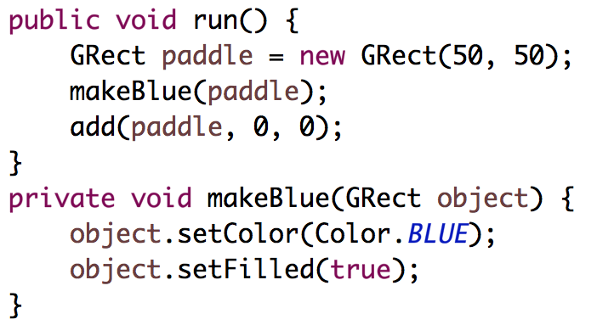

Slide 55
stack
heap
run
paddle

Slide 56
stack
heap
run
paddle

Slide 57
stack
heap
run
18
paddle
18
makeBlue
object

Slide 58
stack
heap
run
18
paddle
18
makeBlue
object
18

Slide 59
stack
heap
run
paddle
makeBlue
object

Slide 60
stack
heap
run
paddle
makeBlue
object

Slide 61
stack
heap
run
paddle
makeBlue
object

Slide 62
stack
heap
run
paddle

Slide 63
stack
heap
run
paddle

Slide 64
#5: when you pass (or return) an object, the address is passed.
Aka reference

Slide 65
What does an object store?

Slide 66
An object stores a memory address!

Slide 67
public void run() {
GRect r = new GRect(50, 50);
}
stack
heap
run
18
r
18

Slide 68
Canvas

Slide 70

Canvas
Heap
Instance Variables
12
canvas
12
run
r
12

Slide 72
Canvas
Heap
Instance Variables
12
canvas
94
mousePressed
e
94
x = 72
y = 94
time = 192332123
obj
12

Slide 73
Canvas
Heap
Instance Variables
12
canvas
94
mousePressed
e
94
x = 72
y = 94
time = 192332123
obj
12

Slide 74
#6: graphics programs all have a “canvas” which keeps track of the objects on the screen

Slide 75
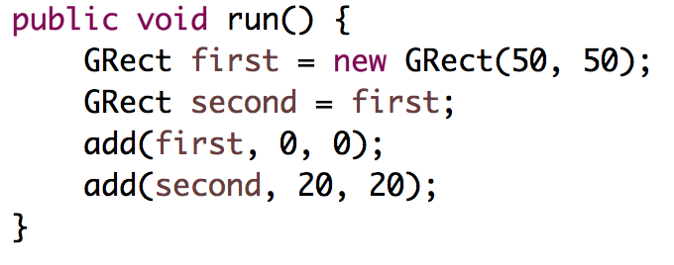
Intentionally left blank so that we can fill it in during lecture

Slide 76
What does an object store?

Slide 77
An object stores a memory address!

Slide 78
Instance Variables

Slide 79
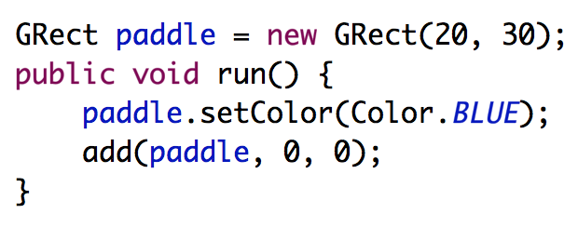
heap
Instance Variables
canvas
paddle

Slide 80
heap
Instance Variables
canvas
paddle

Slide 81
heap
Instance Variables
canvas
paddle
run

Slide 82
heap
Instance Variables
canvas
paddle
run

Slide 83
heap
Instance Variables
canvas
paddle
run

Slide 84
#7: there is space for all instance variables. They are globally accessible

Slide 85
#8: instance variables are initialized before run is called

Slide 86
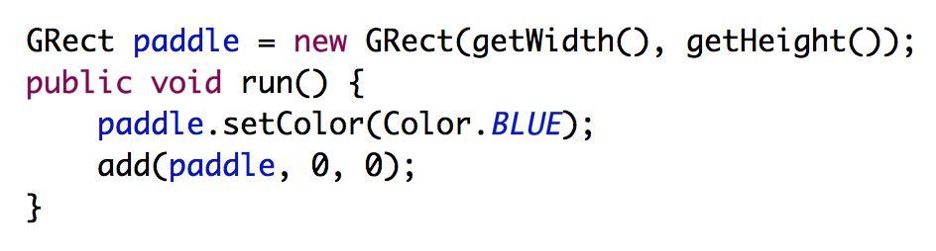
Common Bug
Question: what does this program do?
Answer: makes a square that is 0 by 0 since getWidth is called before the screen has been made.

Slide 87
Today’s Route
You are here
Friday
Instance
Variables
Canvas
The Heap
Core model
The River of Memories

Slide 88
#9: for objects, == checks if the variables store the same address

Slide 89
Recall the start of class?

Slide 90
Who thinks this prints true?

Slide 91
Who thinks this prints true?

Slide 92
What does an object store?

Slide 93
An object stores a memory address!

Slide 94
Learning Goals
Be able to write a large program
Be able to trace memory with references

Slide 95
Beyond CS106A

Slide 96
Beyond CS106A
Heap
run
12
this
76
r
12
Instance Variables
76
Technically, instance variables are stored on the heap and each method has access to a special (hidden) variable called a “this” pointer.
canvas
12

